Slide 1
Implementing a data warehouse using SQL Database engine

Slide 2
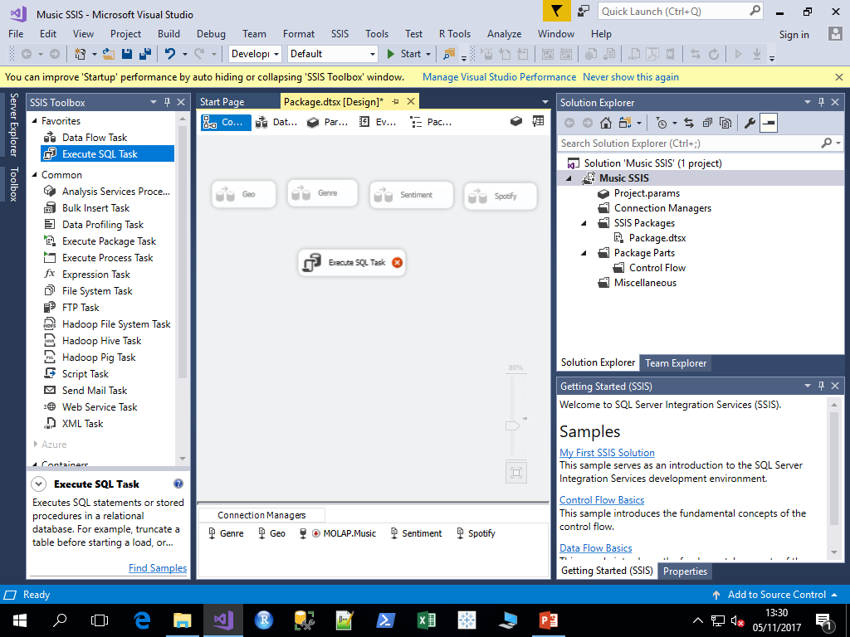
Upload data to dimension and fact tables
1. Connect to MOLAP, create following Dimension tables using SSMS as shown in the previous tutorial
DimGeo
DimSentiment
DimGenre
with same format used while creating RawDataGeo, RawDataSentiment, RawDataGenre
Note: Do not forget primary key declaration
2. In SSIS tool box, drag execute SQL task

Slide 3
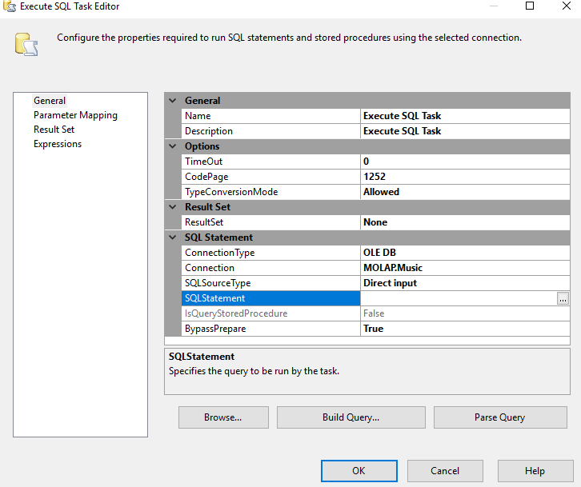
Upload data to dimension and fact tables cont..
3. Double Click on Execute SQL Task > Select
Connection > Execute SQL Statement Box
4. Enter following SQL Script > OK > OK
INSERT INTO [dbo].[DimGeo](
[Geo_ID]
,[State]
,[Country]
,[State_Group_ID]
,[Country_Group_ID])
Select * from RawDataGeo
5. Create SQL Scripts for DimGenre, DimSentiment, place the scripts one below the other and paste it as SQL statement
Note: All the three table’s insert commands should be placed in one script. This script is upload dimension tables SQL statement.

Slide 4
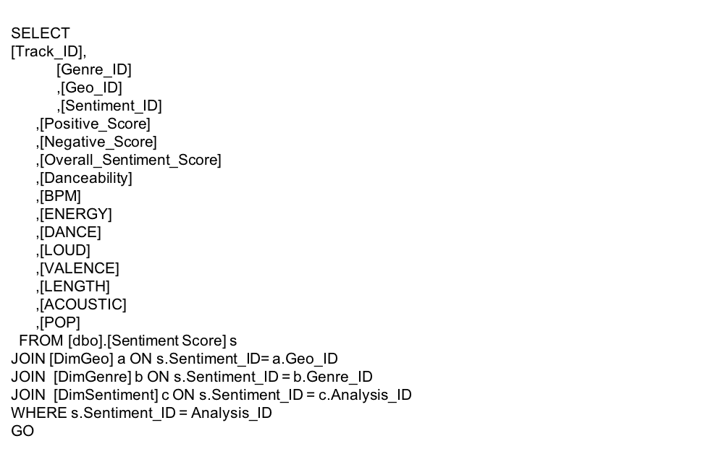
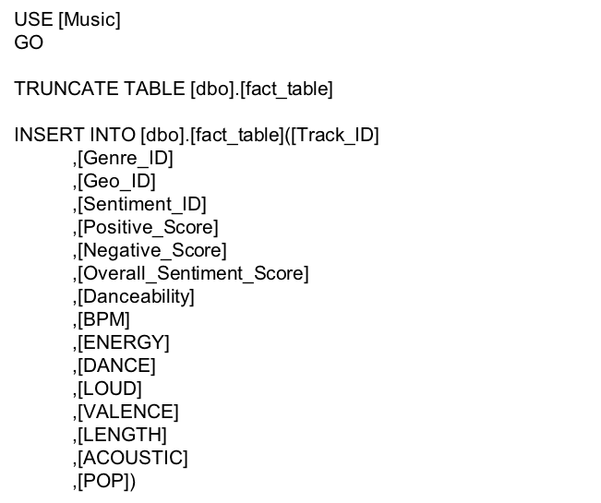
Upload data to dimension and fact tables cont..
6. Pull another SQL Task from SSIS toolbox, Enter following SQL Script > OK > OK
Note: This script is upload fact table SQL statement.

Slide 5
Upload data to dimension and fact tables cont..
7. Finally make sure there are no errors on Execute SQL Task box and Click Start

